Slide 1
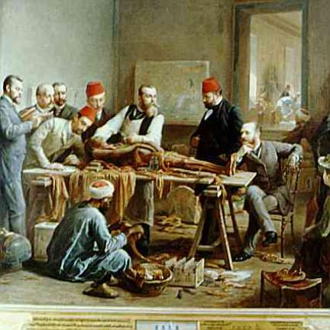
Introduction to anatomy and physiology
CHAPTER 1

Slide 2
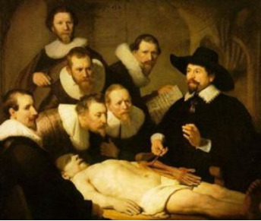
DEFINITIONS
Anatomy – the structure of body parts (also called morphology)
Physiology – the function of body parts; what they do and how they do it

Slide 3
Characteristics of Life…
(1) Movement – self initiated change in position; the motion of internal parts
(2) Responsiveness (irritability) – ability to sense changes within, or around the organism and react to them
(3) Growth - increase in body size
(4) Reproduction – Parents produce offspring/ producing new individuals
(5) Respiration – Obtaining oxygen (O₂), using it to release energy from food substances, and getting rid of wastes

Slide 4
Biological Processes
Digestion – Chemically changing (breaking down) food substances, and getting rid of wastes
Absorption – Passage of digested products (food substances) through membranes and into body fluids
Circulation – movement of substances throughout the body
Assimilation – Changing absorbed substances into chemically different substances (conversion of nutrients into useable forms that are absorbed by the tissues after digestion
Excretion – removal of wastes

Slide 5
Other Characteristics of living things…
Metabolism – all the physical and chemical changes
Bodily needs = food, water, oxygen, heat
Homeostasis – tendency of the body to maintain a stable, balanced, internal environment; “sameness”

Slide 6
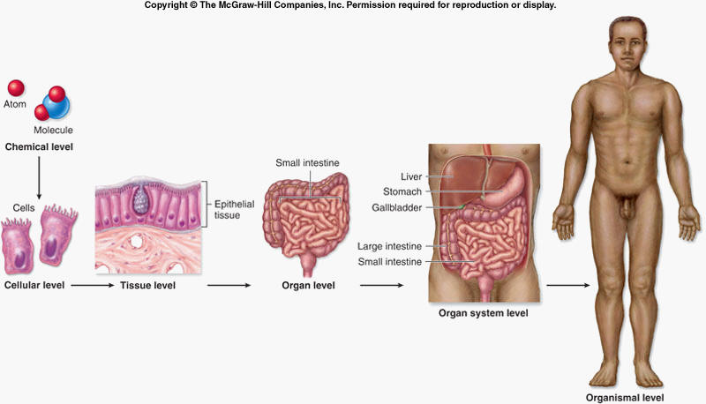
Levels of Organization

Slide 7
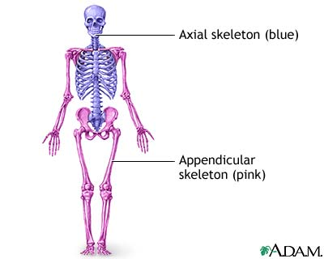
General Organization of the Body
Axial skeleton – head, neck, and trunk
Appendicular skeleton – arms and legs
1. Several body cavities
2. Layers of membranes within cavities
3. Variety of organs and organ systems within cavities
VISCERA = internal organs “visceral organs”

Slide 8
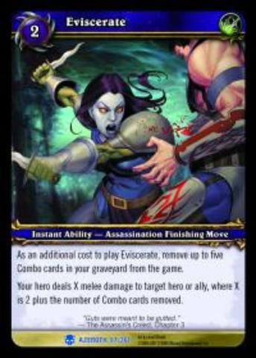
Eviscerate
To disembowel or gut; popular in video games and movies

Slide 9
Body Cavities
Dorsal – back side – cranial cavity holds the brain;
Spinal cavity holds the spinal cord
Ventral – front side
Thoracic – chest region; left and right compartments separated by the mediastinum (heart, lungs, trachea…)
Abdomen – stomach area (spleen, intestines)
Pelvic – lower abdomen (bladder, reproductive organs)
Diaphragm – separates the thoracic and pelvic regions
Serous membrane – covers and surrounds organs
Serous fluid – lubricates organs

Slide 10
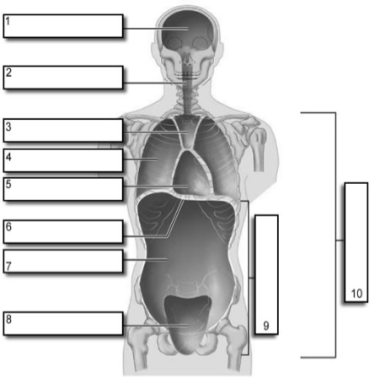
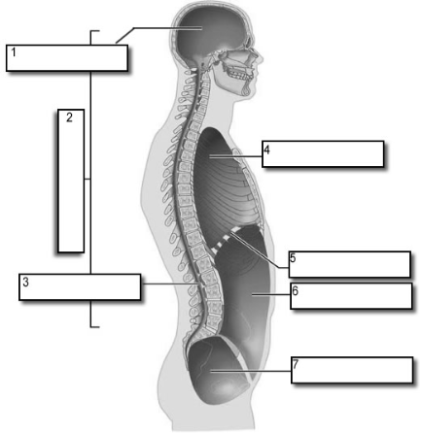
Body Cavities
Easier to visualize the body cavities on pictures (see worksheet)

Slide 11
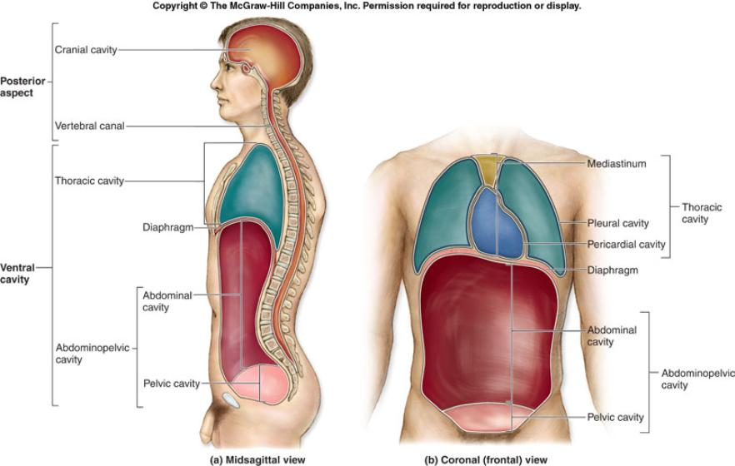
Body Cavities

Slide 12
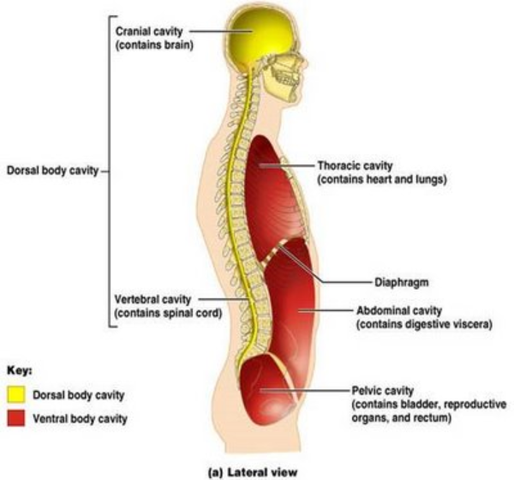
Body Cavities

Slide 13
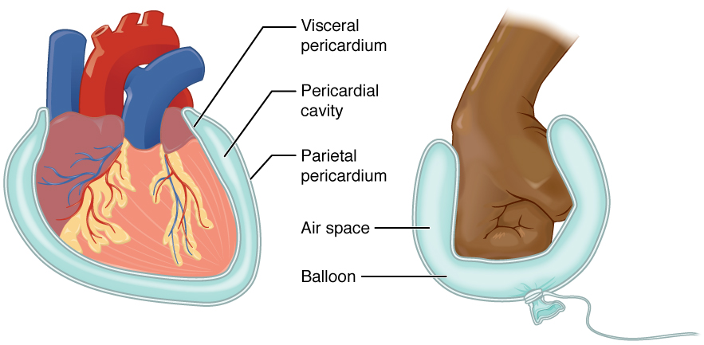
Membranes
Serous membrane - Two layered; covers organs
*Outer layer = parietal
*Inner layer = visceral (lines the organs)

Slide 14
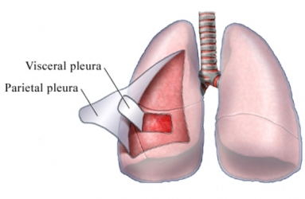
Other Membranes
Pleura = lungs
Pericardium = heart
Peritoneum = organs (abdominopelvic region)
Serous fluid – lubricating fluid

Slide 15
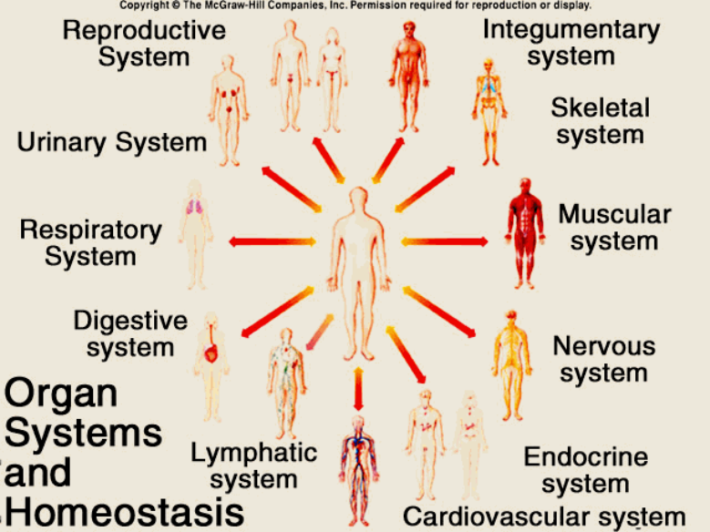
Organ Systems

Slide 16
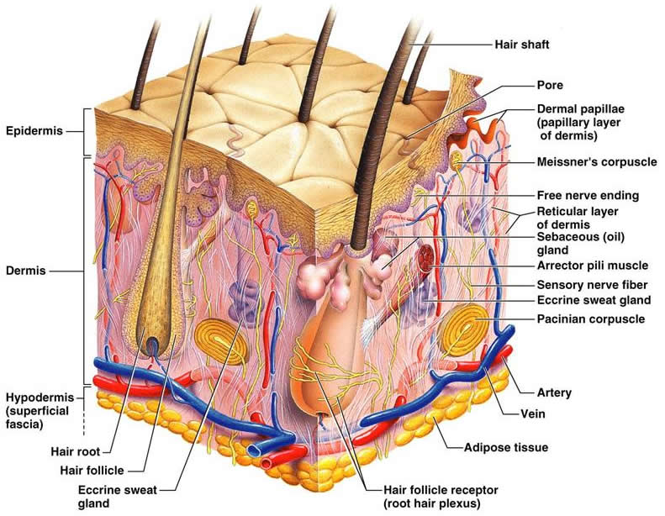
Integumentary System
Covers the body and functions to protect the underlying tissues and regulates body temperature
Includes the hair, nails, skin, and sweat glands

Slide 17
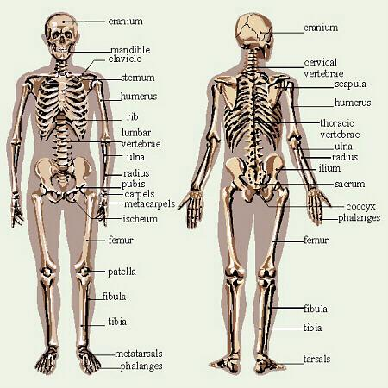
Skeletal System
Includes bone, ligaments, and cartilage
Functions to support, move, and protect the body. Also produces blood cells.

Slide 18
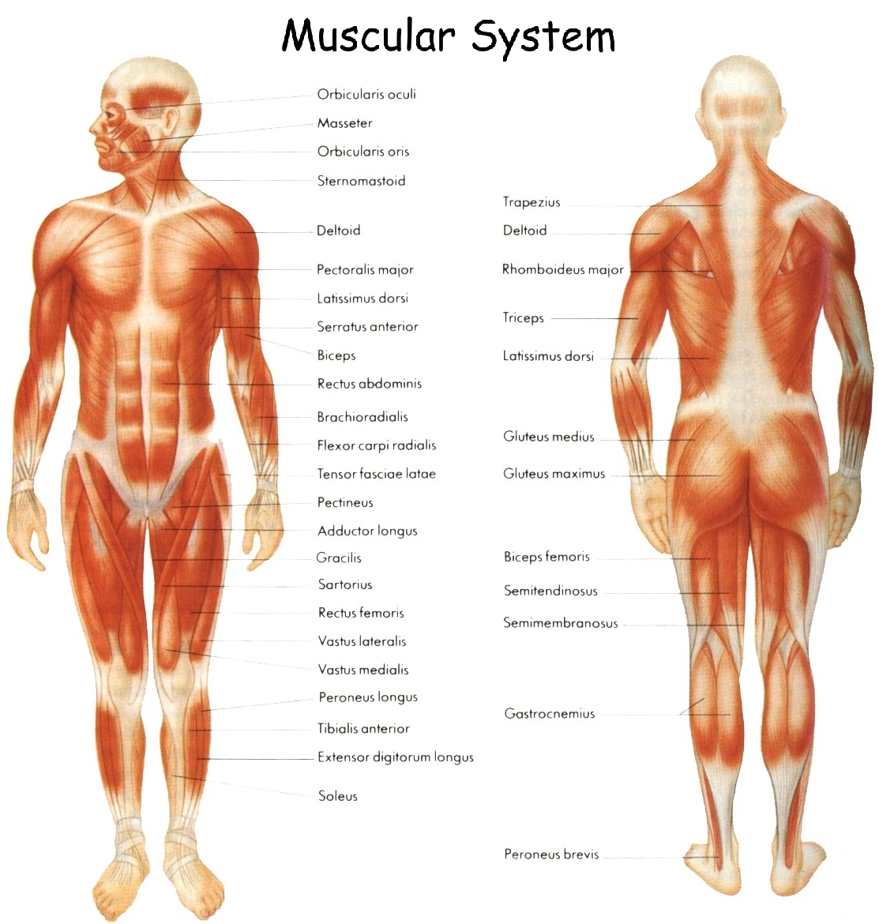
Muscular System
Includes muscles
Functions to create movement, maintain posture, and produce body heat

Slide 19
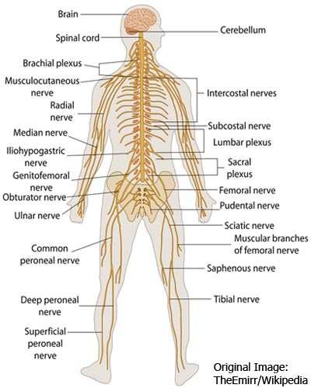
Nervous System
Includes brain, nerves, and spinal cord
Functions include maintaining homeostasis, mental activities, and communicating throughout the body

Slide 20
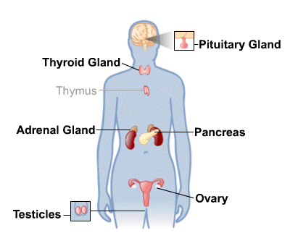
Endocrine System
Includes ductless glands like pituitary, adrenal, thyroid, parathyroid, pancreas, ovaries, testes, thymus, and pineal glands
Functions to secrete hormones and aid in the communication between body parts

Slide 21
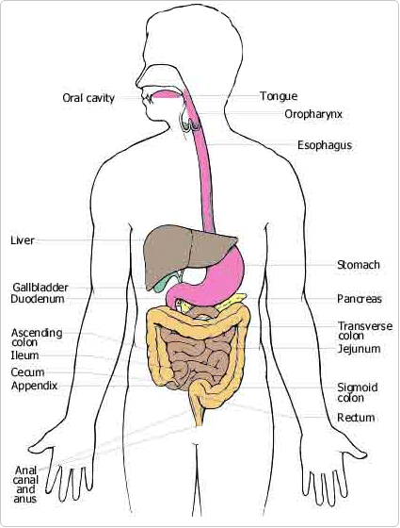
Digestive System
Includes the teeth, mouth, pharynx, esophagus, stomach, small and large intestine, liver, gall bladder, and many glands including the pancreas
Functions to breakdown food substances into simpler forms that can be absorbed

Slide 22
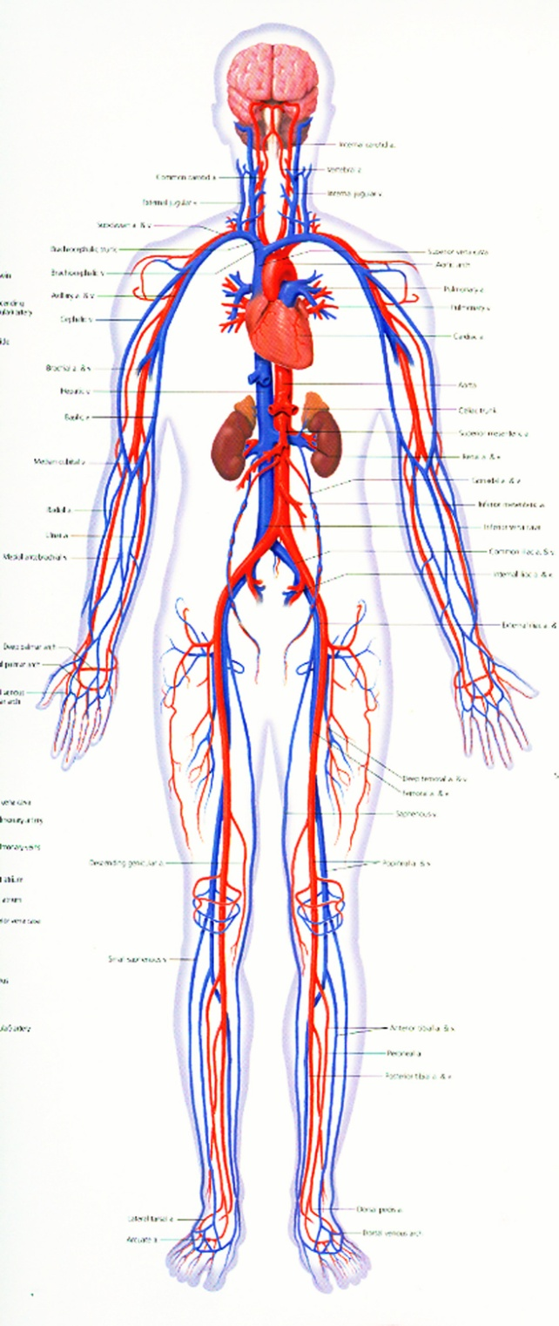
Circulatory System
Includes the heart, blood vessels, and blood
Functions to transport material throughout the body

Slide 23
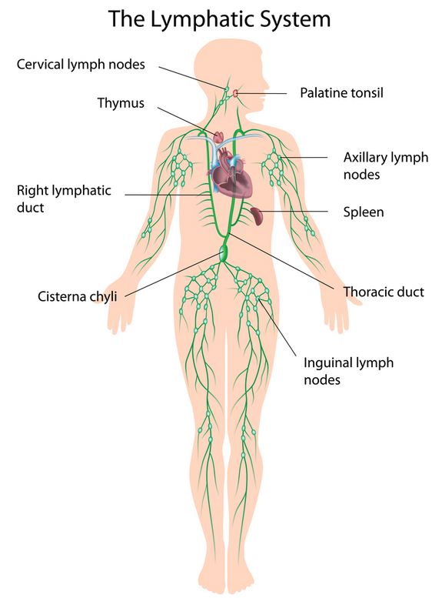
Lymphatic System
Includes lymph nodes
Works with the circulatory system to keep body healthy and fight off infection (immune system)

Slide 24
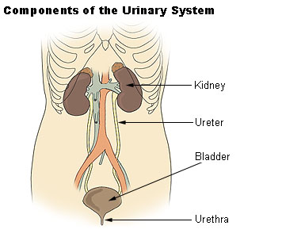
Urinary System
Includes the kidneys, ureters, and bladder
Functions to remove/filter wastes from the blood and helps maintain the body’s water and electrolyte balance

Slide 25
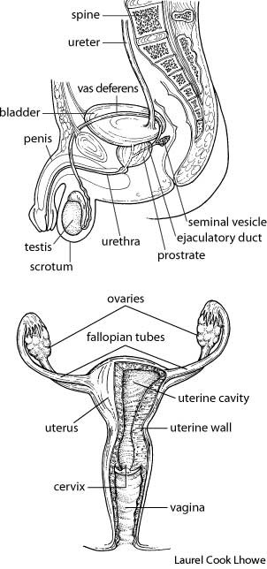
Reproductive System
Includes reproductive organs like ovaries (females) and testes (males)
Functions to produce special reproductive cells for reproduction

Slide 26
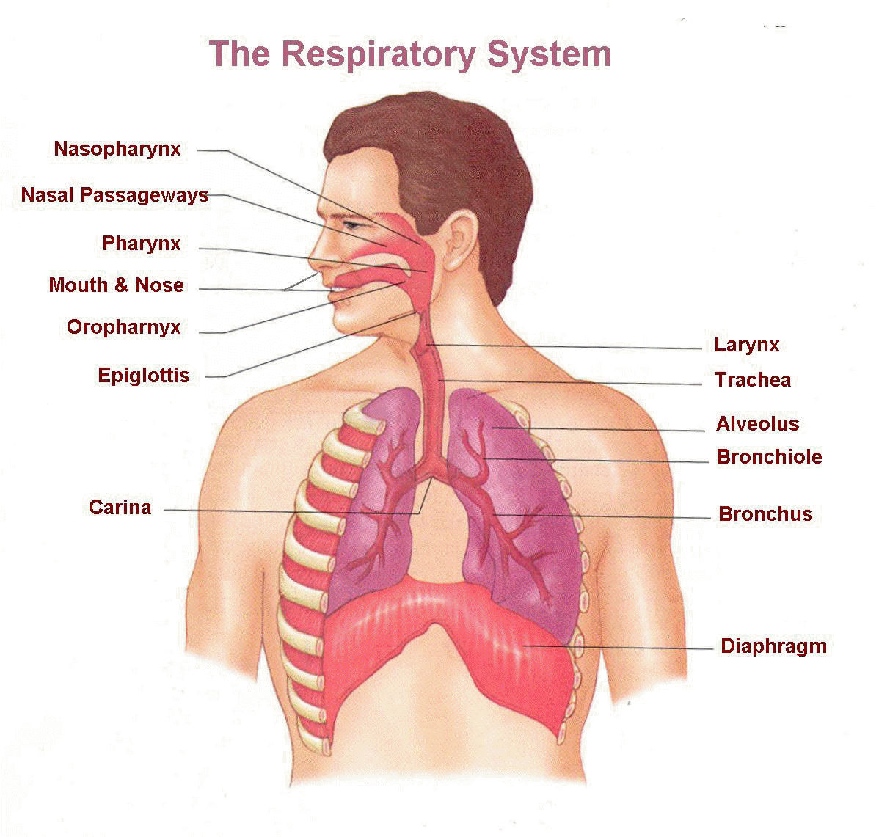
Respiratory System
Includes the trachea, lungs, primary and secondary bronchi, bronchioles, and alevoli sacs
Functions to allow gas exchange to occur in the body (pick up oxygen and drop off carbon dioxide), and to maintain blood pH

Slide 27
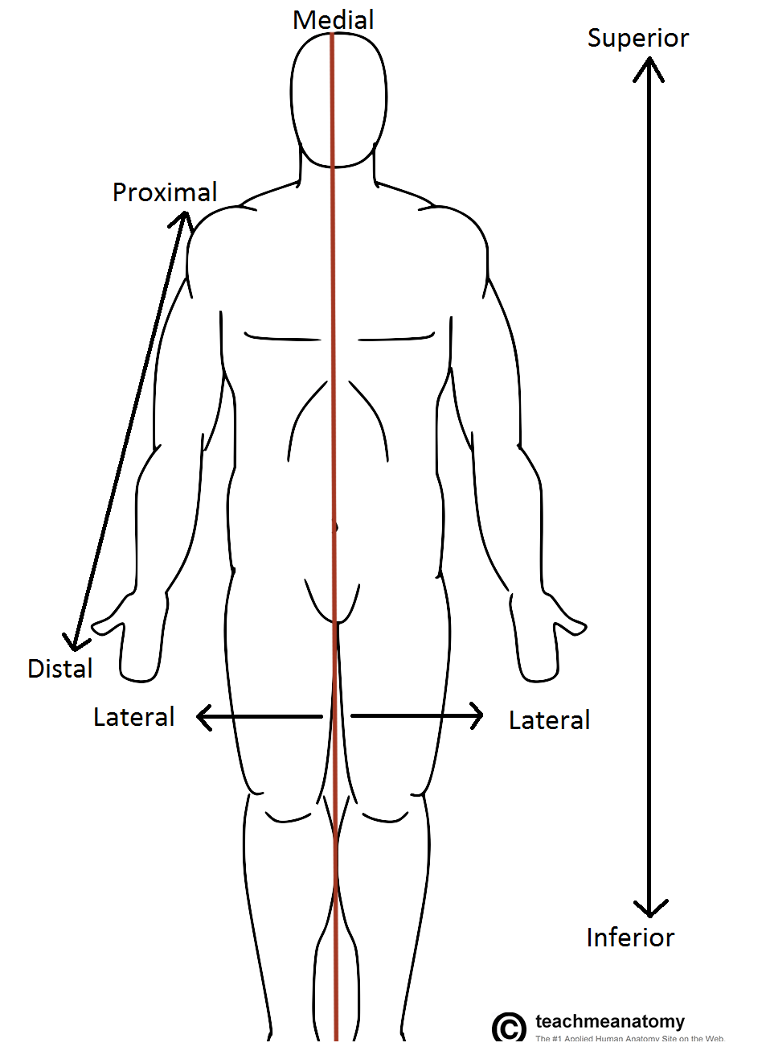
Anatomical Terminology
Anatomical Position – standing erect,
facing forward, arms at side, palms
facing forward
*Study and learn the following terms:
1. Superior
2. Inferior
3. Anterior
4. Posterior
5. Medial
6. Lateral
7. Proximal
8. Distal
9. Superficial
10. Deep

Slide 28
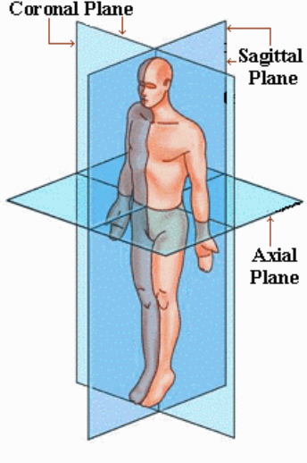
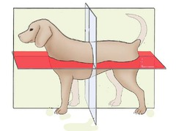
Planes of the Body
Frontal/
Transverse/
*Notice the difference in body planes for a four-legged animal versus a bipedal human

Slide 29
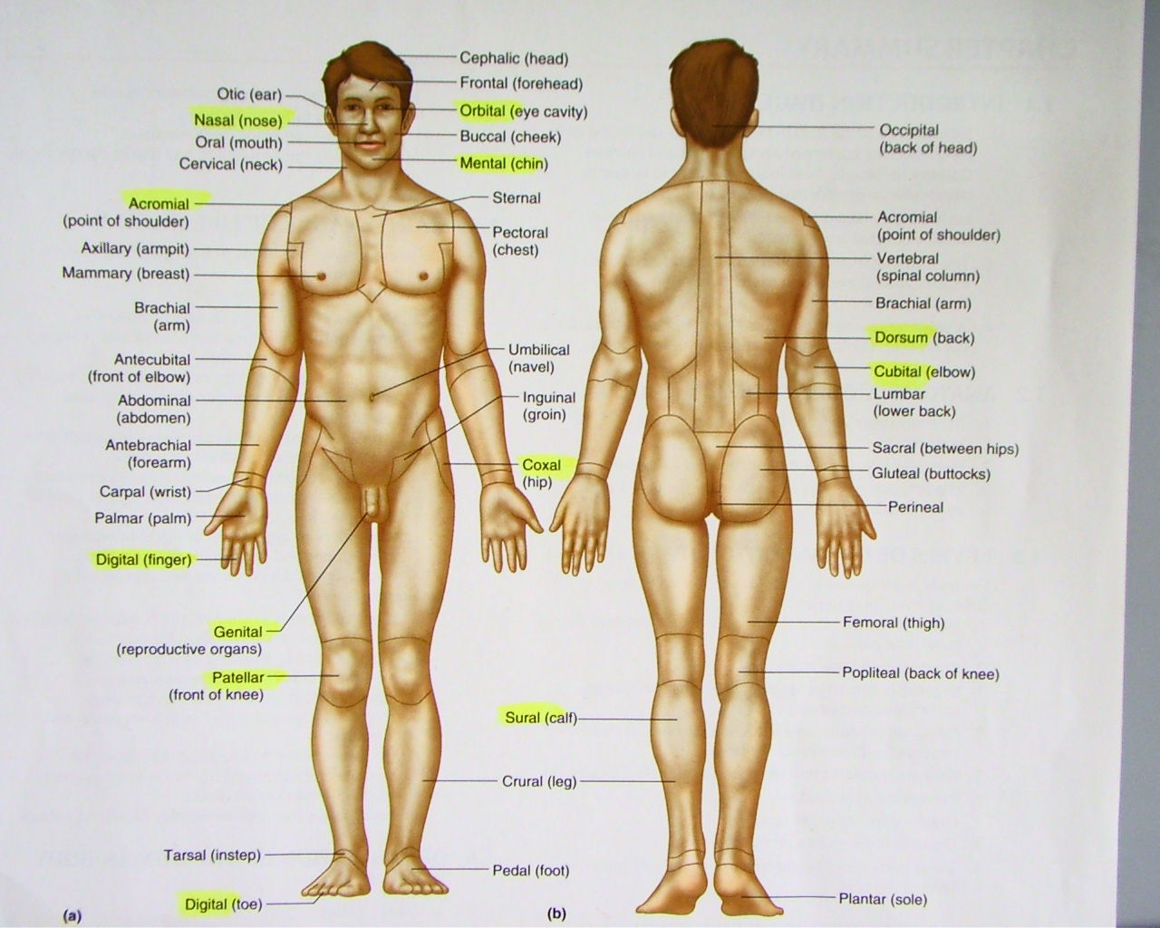
Body Regions by Name

Slide 30
Homeostasis
Homeostasis describes the body’s ability to maintain relatively stable internal conditions even though the outside world is constantly changing
It indicates a dynamic state of equilibrium, or a balance where internal conditions change and vary within narrow limits
Every organ system works to maintain equilibrium inside the body

Slide 31
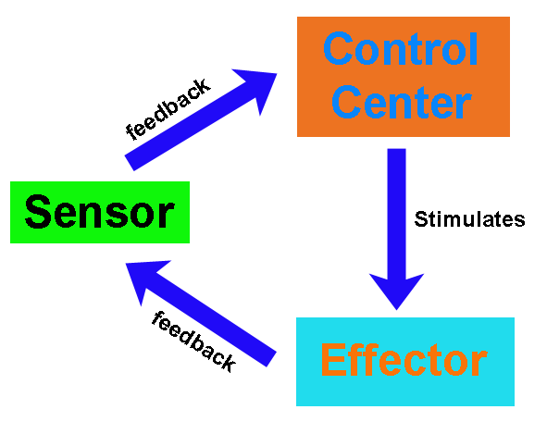
Homeostasis
At least three components exist for homeostatic control center:
(1) Receptor
(2) Control center
(3) Effector

Slide 32
Homeostasis: Receptor
The receptor is some type of sensor that monitors and responds to changes in the environment (stimulus)
The receptor responds to the stimulus by sending information (called input) to the control center (brain)
Examples of receptors can include: temperature receptors in the skin, glands in the endocrine system, pain receptors, nerves, etc

Slide 33
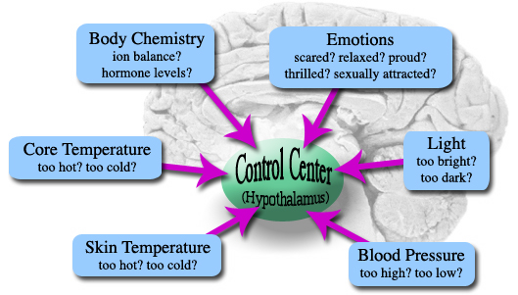
Control Center
The control center (brain) determines the set point or level that a variable must be maintained at
The control center analyzes the information it receives from the receptors and then determines the appropriate response or course of action

Slide 34
Effector
The effector provides the means for the control center’s response to the stimulus. It sends information from the control center (called output) and produces a response called an effect. The results of the response then feedback to influence the stimulus by either depressing it (negative feedback) so that the entire mechanism is shut off, or enhancing it (positive feedback) so that the reaction occurs at an even faster rate.

Slide 35
Feedback Systems
Most homeostatic control mechanisms are negative feedback systems!
EX: Your home heating system. If the thermostat is set at 68°F, the heating system will be turned ON when the house temperature drops below that setting. As it produces heat, the air is warmed. When the temperature goes back up to 68°F or slightly higher, the thermostat sends a signal to turn the furnace off.
What is the receptor in this example? The control center? The effector?
Receptor: Thermostat; Control center: Thermostat; Effector: furnace

Slide 36
An Example of Negative Feedback…
Homeostasis of Blood Pressure is an example of Negative Feedback.
If a stimulus (such as stress) causes blood pressure (controlled condition) to rise, pressure sensitive nerve cells (receptors) in certain arteries send impulses (input) to the brain (control center).
The brain sends impulses (output) to the heart (effector) which causes the heart rate to decrease (response) and the return of normal blood pressure and thus, restoration of homeostasis.

Slide 37
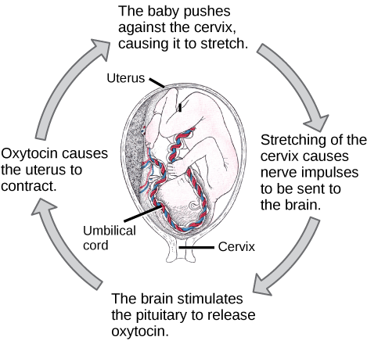
An Example of Positive Feedback…
Because they tend to increase the stimulus and push the levels that a variable must be maintained at farther, positive feedback systems are much more rare.
Usually occur infrequently and do not require continuous adjustments
EX: Birth

Slide 38
Homeostatic Imbalance
Homeostasis is crucial for good health! In fact, it is so important, that we consider diseases to occur as a result of homeostatic imbalance.
As we age, our organs become less efficient and our internal environments become less stable. These events make us more susceptible to disease.

Slide 39
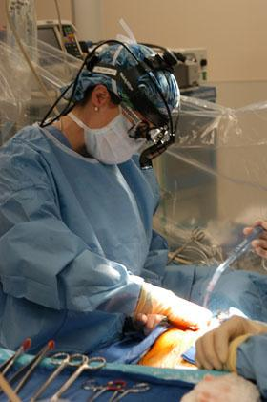
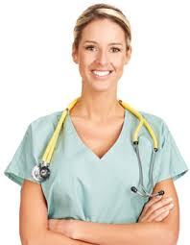
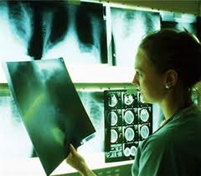
Careers in Medicine
There are tons of careers, some of them only require a short term of training. What are your goals?
Medical and Applied Science sheet

